Slide 1
Fuad Hasan
GEOG 4057
Guided Project 2
Working with Google earth engine

Slide 2

I made sure all my packages are installed and working correctly

Slide 3
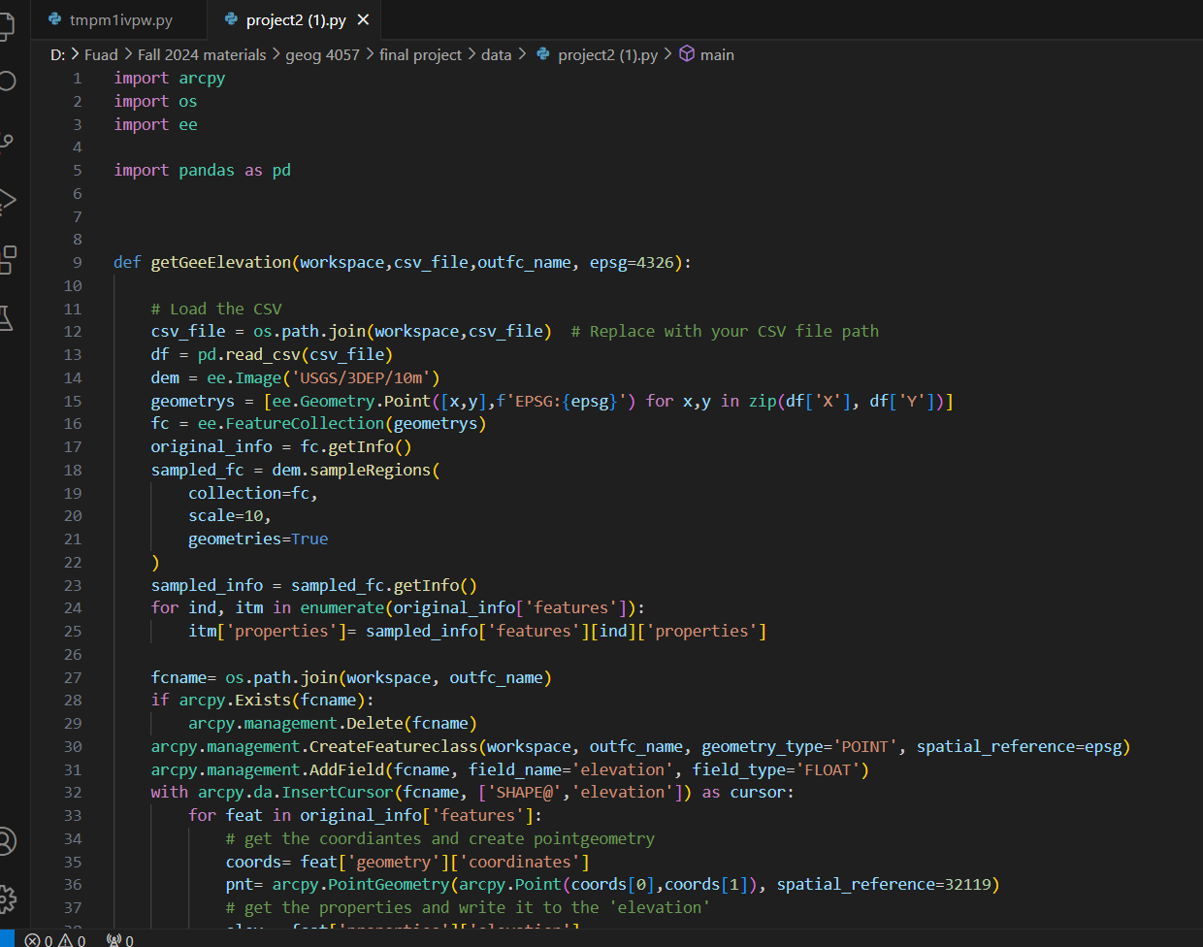
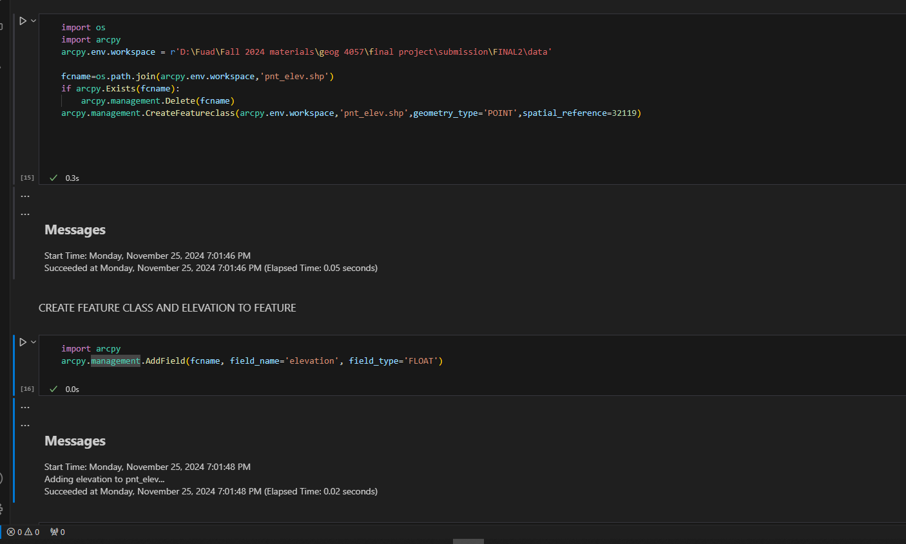
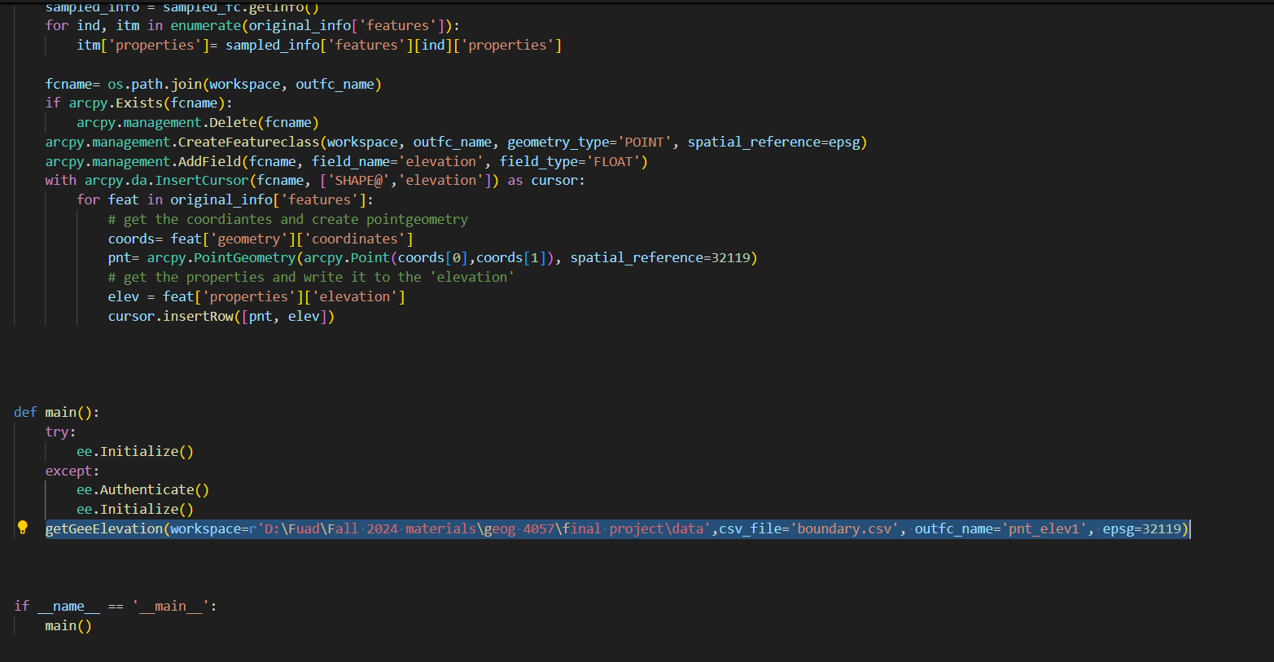
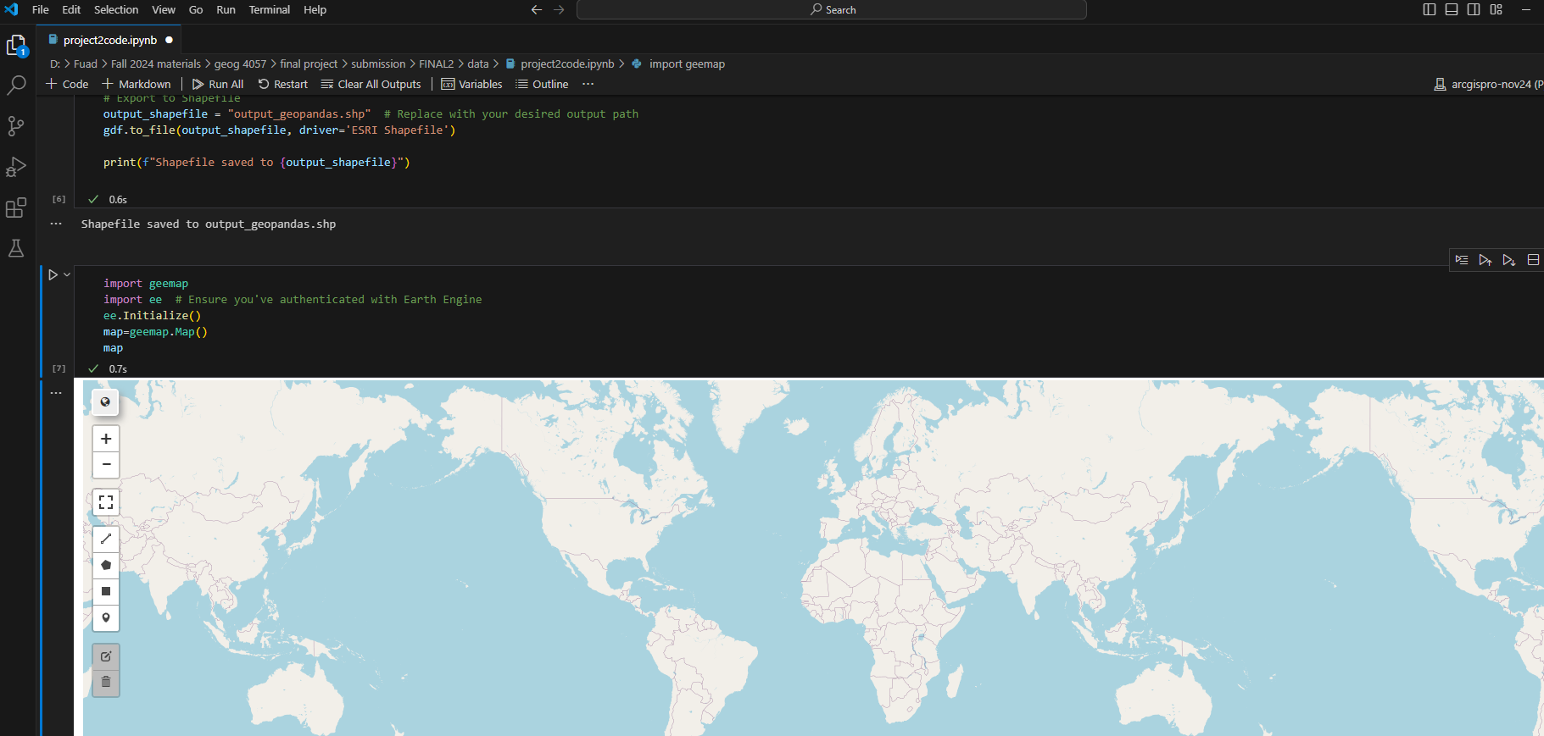
Exploring the data in python and working with geemap and ee

Slide 4
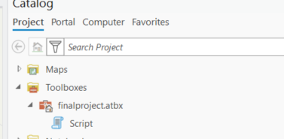
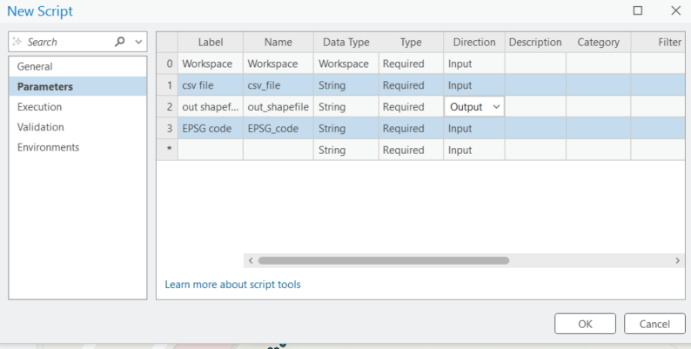
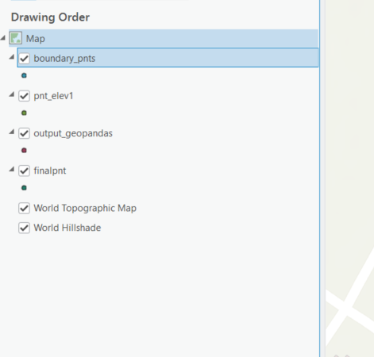
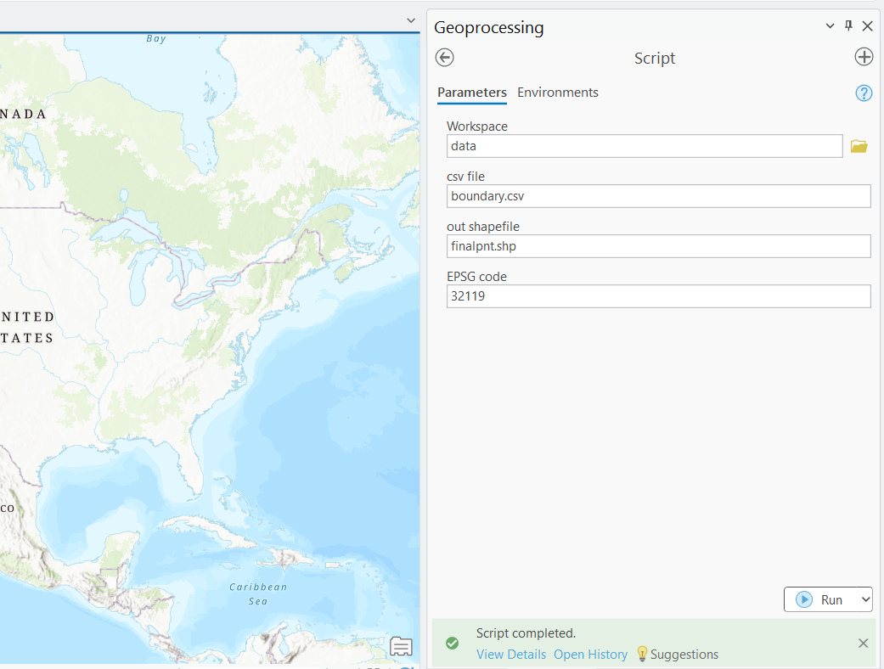
Here, Setting up the script and running with the necessary files in ArcGIS Pro
Using code
Using user input in code
Using geopandas
Using script

Slide 5
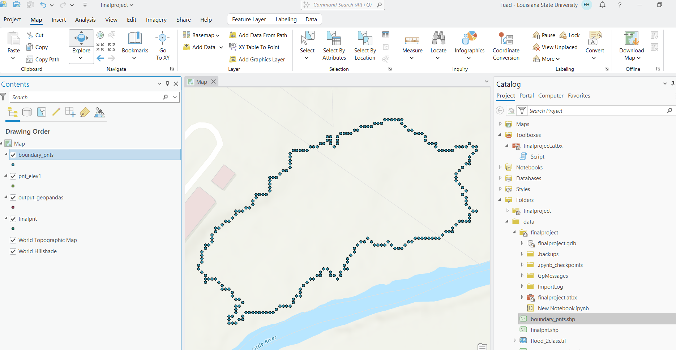
Final file

Slide 6
